Slide 2
Taming GPU Compute with C++ AMP C++ Accelerated Massive Parallelism
Steve Teixeira
Director of Program Management
Microsoft Parallel Computing Platform

Slide 3
Agenda
Why GPU compute?
Overview of C++AMP
Full Visual Studio Integration and Support

Slide 4
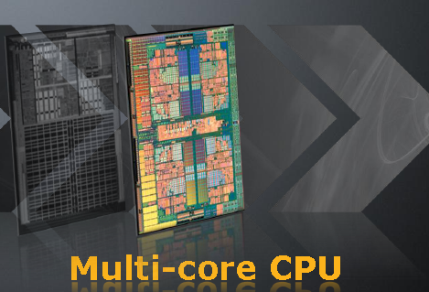
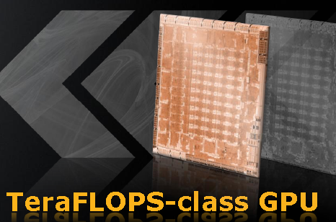
Rapidly Changing Processor Architectures
~1 billion transistors @45 nm
Multi-tasking, I/O, virtualization
Supports general code
Low memory bandwidth
Medium level of parallelism
Deep execution pipelines
Higher power consumption
~2 billion transistors @40 nm
Programmable and fixed function
Graphics and data-parallel code
High memory bandwidth
High level of parallelism
Shallow execution pipelines
Lower power consumption
Source: AMD

Slide 5
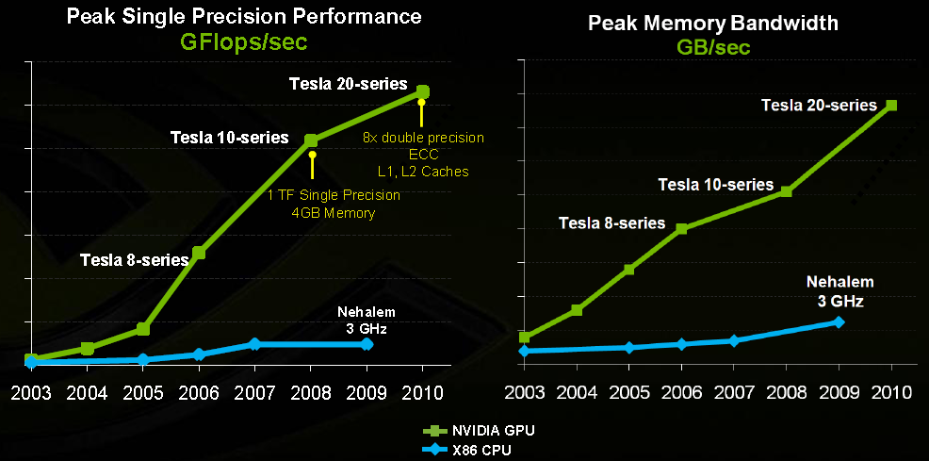
Performance Gap Widens Further
Source: NVIDIA

Slide 6
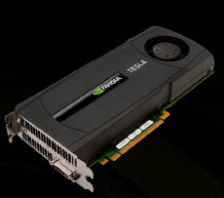
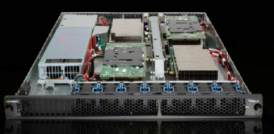
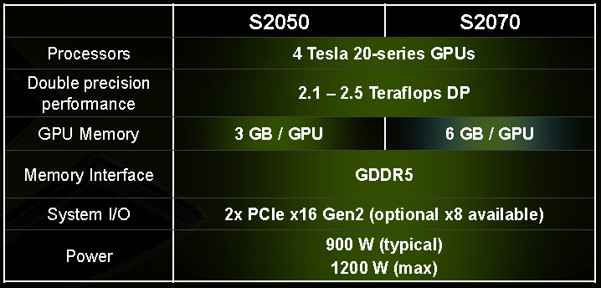

Current GPU Performance

Slide 7
GPU vs. CPU Performance
Demo
n-Bodies in C++AMP

Slide 8

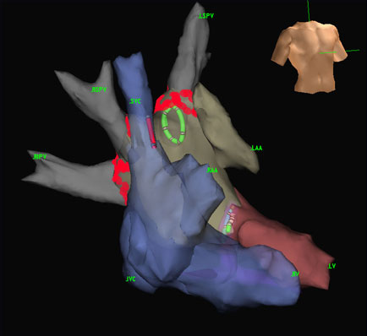
Data Parallel and GPU Acceleration
Expose extreme performance of GPUs for graphics and computation
Provide developers the ability to get significant performance gains
Demand for a single application image that runs on GPU hardware from multiple vendors
Ray tracing
Medical tomography

Slide 9
Leveraging a C++ Programming Model
Goals
Performance: Unleash the power of the hardware
Productivity: Use C++ skills for commodity hardware
Portability: Write once, run on multiple platforms
Themes
Protect coding investment in the long run
Increase expressiveness as hardware evolves
Leverage existing developer skills on language and tools

Slide 10
C++AMP
Will be integrated into Visual Studio and the VC++ Compiler
Building on the DirectX® runtime stack
Ubiquitous and reliable
Enables broad range of developers to leverage modern data parallel architectures
Higher-level abstractions
Low-level hardware access
Code authoring, debugging, and profiling support provided within Visual Studio
We intend to support a library ecosystem

Slide 11
Data Parallel Programming C = A * B
A
0
1
2
3
…
n
B
0
1
2
3
…
n
GPU
CPU
C
0
1
4
9
…
n²
ALU
ALU
Control
ALU
ALU
Cache
DRAM
DRAM
void MatrixMult(float * C, const float * A, const float * B, int M, int N, int W )
{
for (int x = 0; x < W; ++x)
for (int y = 0; y < N; ++y)
{
float sum = 0;
for(int i = 0; i < M; i++)
sum += A[x*M+i] * B[i*W+y];
C[x*W+y] = sum;
}
}
void MatrixMult( float * C, const float * A, const float * B,
int M, int N, int W )
{
array_view<const float,2> a(M,W,A), b(W,N,B);
array_view<float,2> c(M,N,C);
parallel_for_each(c.grid, [=](index<2> idx)
restrict(direct3d) {
float sum = 0;
for(int i = 0; i < a.x; i++)
sum += a(idx.y, i) * b(i, idx.x);
c[idx] = sum;
});
}
void MatrixMult(float * C, const float * A, const float * B, int M, int N, int W )
{
parallel_for(0, W, [&](int x) {
for (int y = 0; y < N; ++y)
{
float sum = 0;
for(int i = 0; i < M; i++)
sum += A[x*M+i] * B[i*W+y];
C[x*W+y] = sum;
}});
}

Slide 12
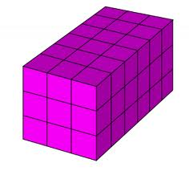
grid, index, and array_view
using namespace Concurrency;
void MatrixMultiply( vector<float>& C,
const vector<float>& A,
const vector<float>& B,
int M, int N, int W )
{
array_view<const float,2> a(M,W,A);
array_view<const float,2> b(W,N,B);
array_view<writeonly<float>,2> c(M,N,C);
parallel_for_each(c.grid, [&](index<2> idx)
restrict(direct3d)
{
float sum = 0;
for(int i = 0; i < a.x; i++)
sum += a(idx.y, i) * b(i, idx.x);
c[idx] = sum;
});
}
grid<N>
Determines the shape of data and the scope of computation
index<N>
An N-dimensional vector used to index a point in a multidimensional array
array_view<T,N>
Multidimensional array of rank N with element type T
Container for data used on accelerator
grid<3> e3(6,3,3);
index<3> i3(2,0,1);

Slide 13
Restriction Qualifiers
Function or lambda modifier with a restriction qualifier
Restriction qualifiers inform compiler of “intent” or “behavior”
Allows optimizations or special code-gen behavior
Defined qualifiers
direct3d and potentially others
Syntax examples:
void Compute(double &x, array<double>& z, int i) restrict(direct3d)
{
x = z[i] * z[i+1];
}

Slide 14
direct3d Restriction Qualifier
Functions and lambdas intended to execute on a Direct3D graphics device
Capable of executing on any DX11 device
Restrictions follow limitations of DX11 device model
Shader Model 5
No 1-byte or 2-byte data types
No function pointers or virtual methods
Can only call other direct3d functions
Many other restrictions…
Other C++ language features work as expected

Slide 15
restrict(direct3d) Compilation Chain
C++ source file
regular C++ code
VC++ compiler
C++ linker
C++AMP code
HLSL code gen
fxc shader compiler
Executable

Slide 16
Example: Target Restrictions
// Overload on target
float cos(float) restrict(direct3d,fpga)
{
Baz *pBaz = new Baz(v); // error
return _TaylorSeries_cos(v);
}
float cos(float v) restrict(cpu)
{
return _x64_FastCos(v);
}
// Target-polymorphic call site
float foo(float v)
{
return cos(v);
}

Slide 17
‘auto’ restriction specifier
template <typename Func>
inline void my_generic_algorithm(Func f) restrict(auto)
{
f();
}
Lets the compiler decide effective restrictions for inline functions (not for forward declarations)
Directly using existing template types and algorithms (and new ones) without annotation
std::complex class
std::for_each algorithm
…
Inferring ‘auto’
// Compile with /Zauto
namespace std {
template <typename II, typename Func>
Func for_each(II first, II last, Func f)
// implies restrict(cpu,auto)
{
for( ; first!=last; ++first ) f(*first);
return f;
}
}

Slide 18
parallel_for_each
using namespace Concurrency;
void MatrixMultiply( vector<float>& C,
const vector<float>& A,
const vector<float>& B,
int M, int N, int W )
{
array_view<const float,2> a(M,W,A);
array_view<const float,2> b(W,N,B);
array_view<writeonly<float>,2> c(M,N,C);
parallel_for_each(c.grid, [=](index<2> idx)
restrict(direct3d)
{
float sum = 0;
for(int i = 0; i < a.x; ++i)
sum += a(idx.x, i) * b(i, idx.y);
c[idx] = sum;
});
}
Initiates parallel execution on an accelerator
Semantics:
Invoke the functor for each point in the grid
Arbitrary order for the activities
parallel_for_each is as-if synchronous in terms of visible side effects

Slide 19
Data Parallel Accelerators
Abstraction for one or more data parallel accelerators
One or more Direct3D 11 GPUs
Multiple GPUs
CPU vector processor
Many-core CPUs
Host and accelerator are separate in the model
Data transfer to/from accelerator
Could be optimized away for integrated memory architecture
accelerator_view
‘Handle’ to an accelerator
Host
Accelerator
CPUs
PCIe
GPU
System memory
GPU
GPU
GPU

Slide 20
Performance-oriented topics
Use thread groups (tiles) and shared memory for performance
tile_static storage modifier
Define shared memory for threads in the tile
tile_barrier
Barrier for all threads in the tile
Tiled form of parallel_for_each
tiled_grid to define dimensions
tiled_index
Specialized index with tile coordinates

Slide 21
Matrix multiply with tiles
void MatrixMultiplyTiled( vector<float>& C, const vector<float>& A,
const vector<float>& B, int M, int N, int W )
{
array_view<const float,2> a(M,W,A), b(M,W,B);
array_view<writeonly<float>,2> c(M,W,C);
parallel_for_each(c.grid.tiled<16,16>(),[&](tiled_index<16,16> ti)
restrict(direct3d)
{
// Use tile static memory for working with a tile
tile_static fixed_array<float,16,16> localA;
tile_static fixed_array<float,16,16> localB;
for (int t = 0; t < a.y; t += 16)
{
localA.load(a.section(ti.tile_origin.y, t, 16, 16));
localA.load(b.section(t, ti.tile_origin.x, 16, 16));
float sum = 0;
for (int i=0; i < 16; i++)
sum += localA(ti.local.y,i) * localB(i,ti.local.x);
}
c[ti] = sum;
});
}
Example of tiled forall

Slide 22
Integrated Developer Tools
Use C++AMP features and classes with full support from the Visual Studio IDE
IntelliSense
colorization
Debug compute intensive code segments that execute on GPUs
GPU emulator
GPU hardware
Concurrency Visualizer provides integrated view of activity on CPU and GPU

Slide 23
Debugging Experience
Well known Visual Studio debugging features
Launch, Attach, Stepping, Breakpoints
Processes, Debug Output, Modules, Disassembly
Call Stack, Memory, Registers, Locals, Watch, Quick Watch, DataTips
New features (for both CPU and GPU)
Parallel Stacks window, Parallel Watch window, Barrier
New GPU-specific
GPU Threads window

Slide 24
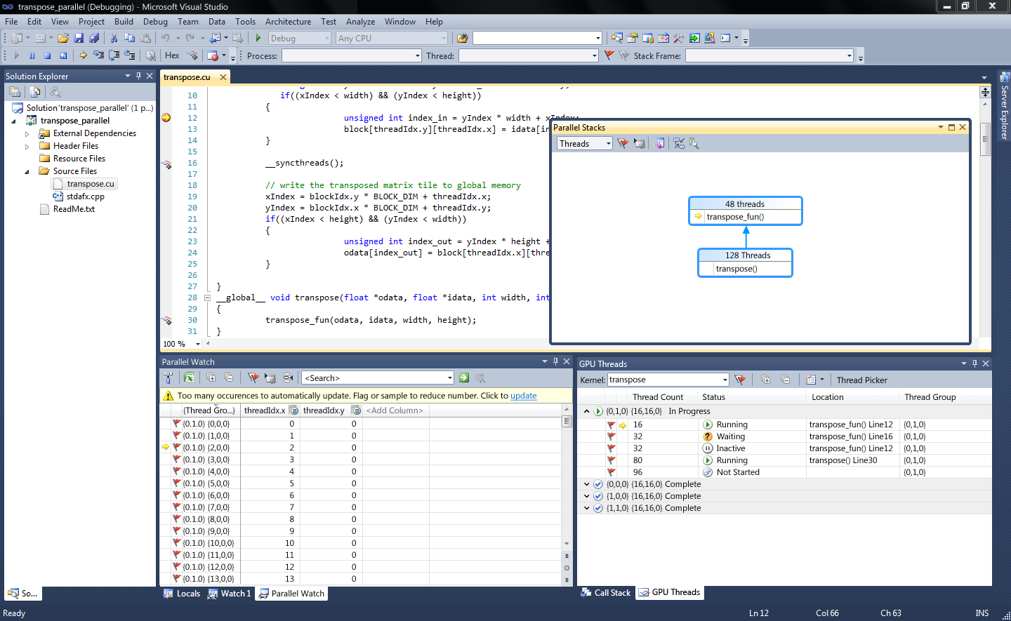
GPU Debugging
Bring CPU debugging experience to GPU

Slide 25
Concurrency Visualizer Support for GPGPU
Profiler combines GPU support with the CPU threads experience
Goal is to analyze high-level performance metrics
Memory copy overheads
Synchronization overheads across CPU/GPU
GPU utilization and contention with other processes
DirectX-centric
Supports any library/programming model built on it

Slide 26
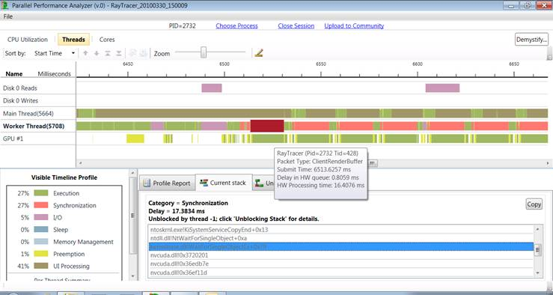
Concurrency Visualizer for GPU

Slide 27
Taming GPGPU Compute with C++ AMP
Questions?

